Slide 1
Submerged Arc Welding ANSYS APDL analysis
Modal analysis of Mild Steel plates before and after SAW

Slide 2
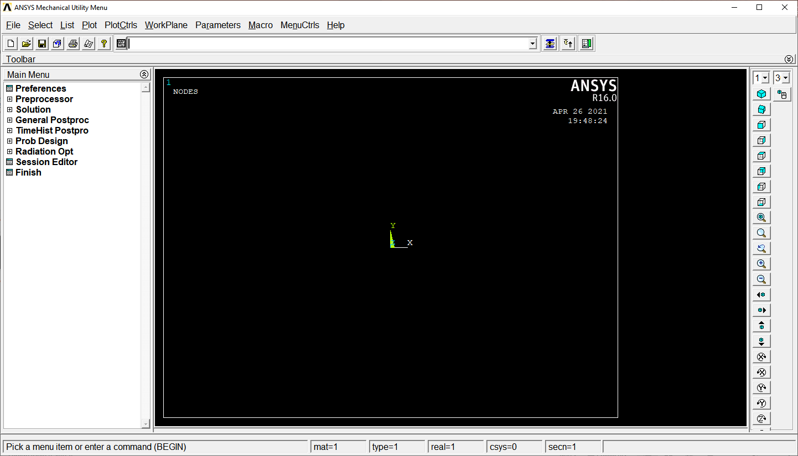
ANSYS APDL main screen
Command Line
Main Menu
Geometry Display

Slide 3
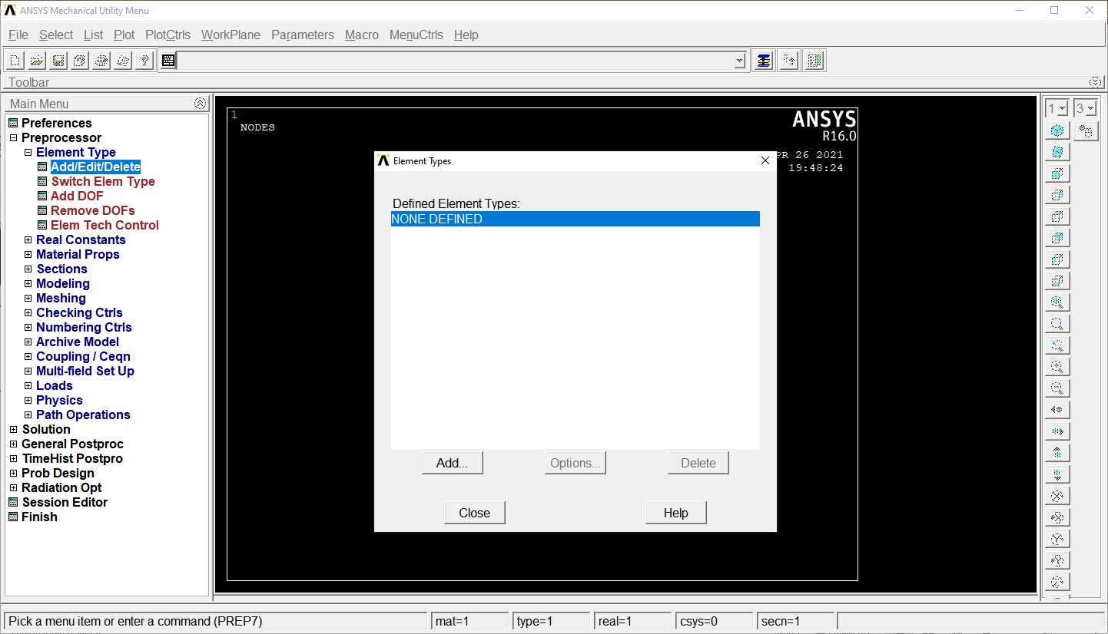
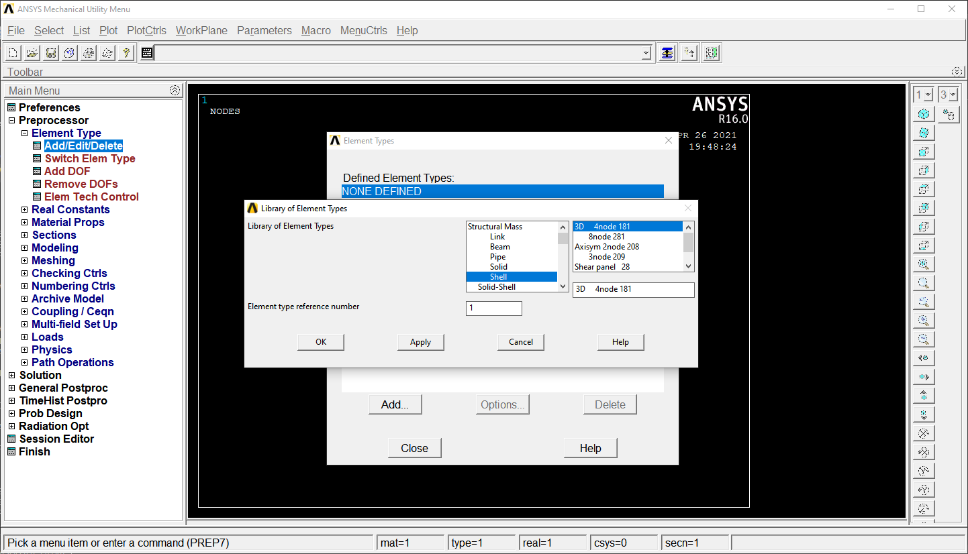
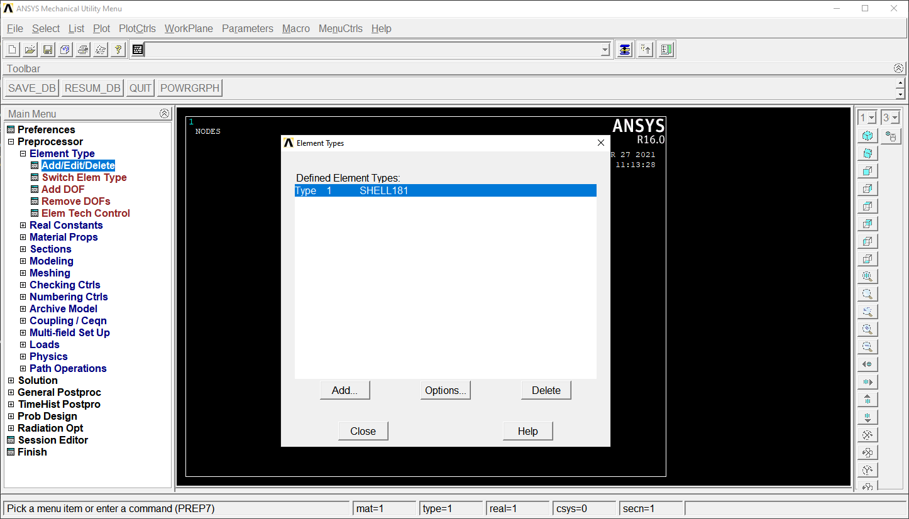
1
Select Element type
SHELL 181
4 noded element

Slide 4
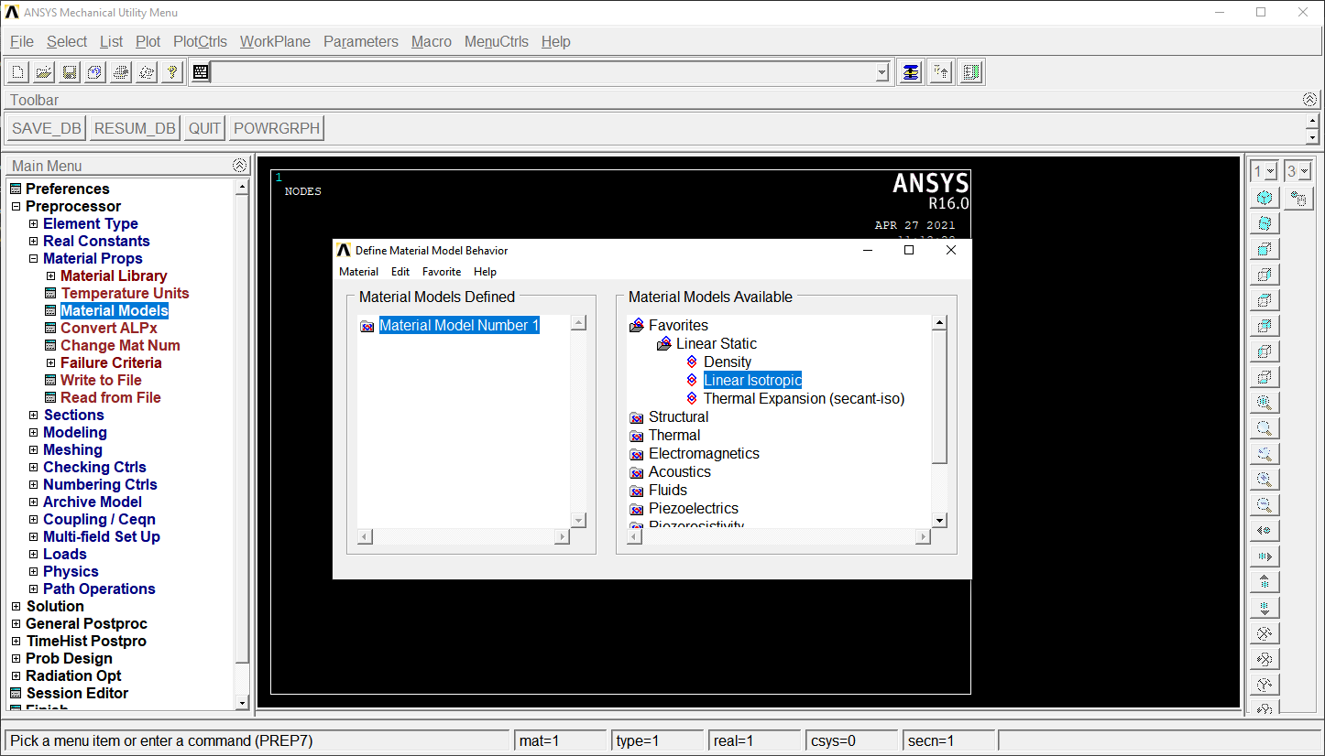
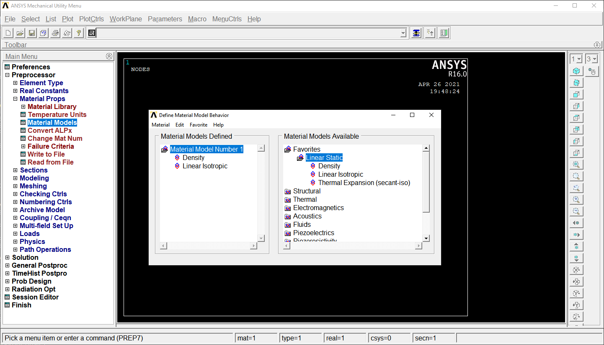
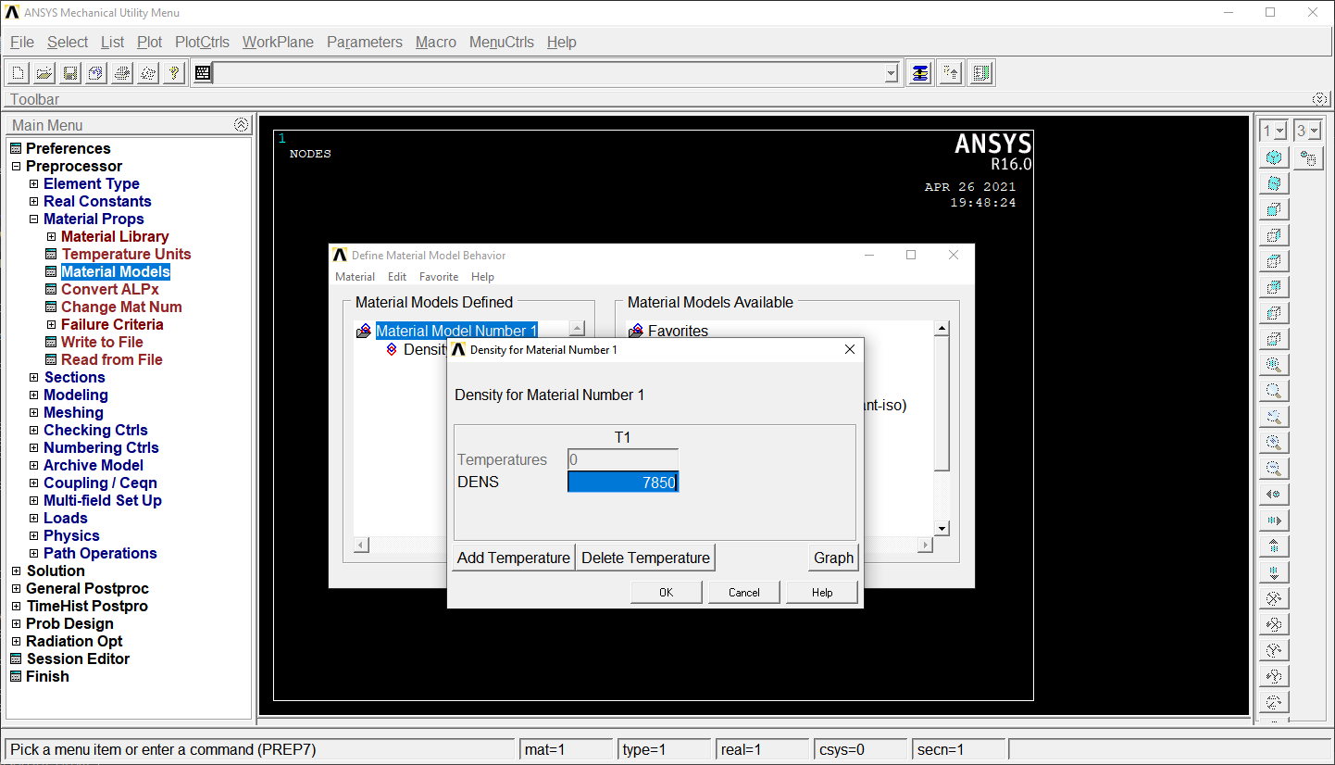

2
Add Material Property
Ex =2.1e11
PRxy = 0.3
DENS = 7850

Slide 5
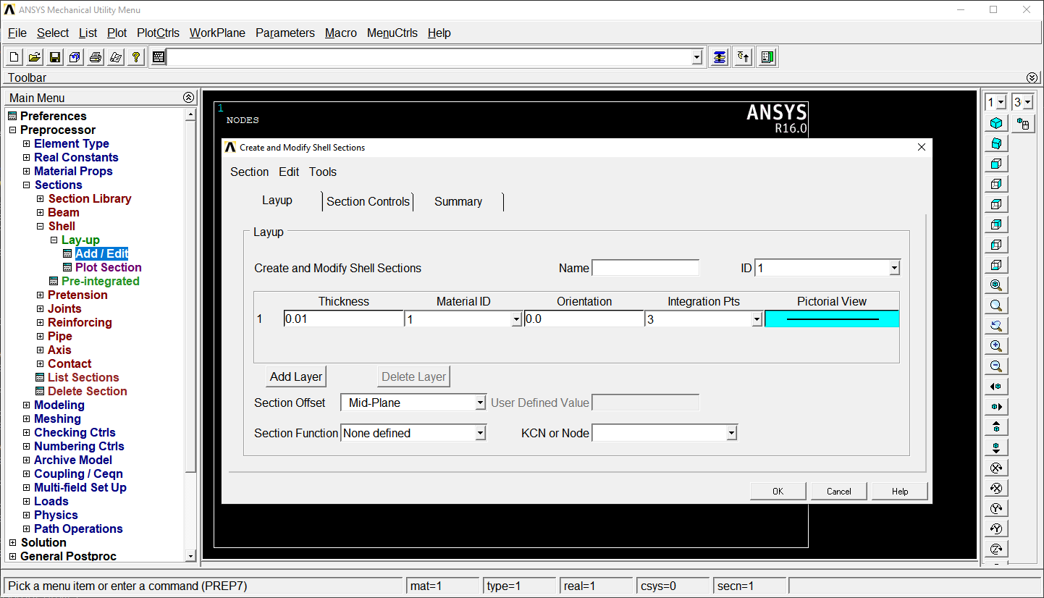
3
Add Plate Cross-Section
Thickness = 0.01 m

Slide 6
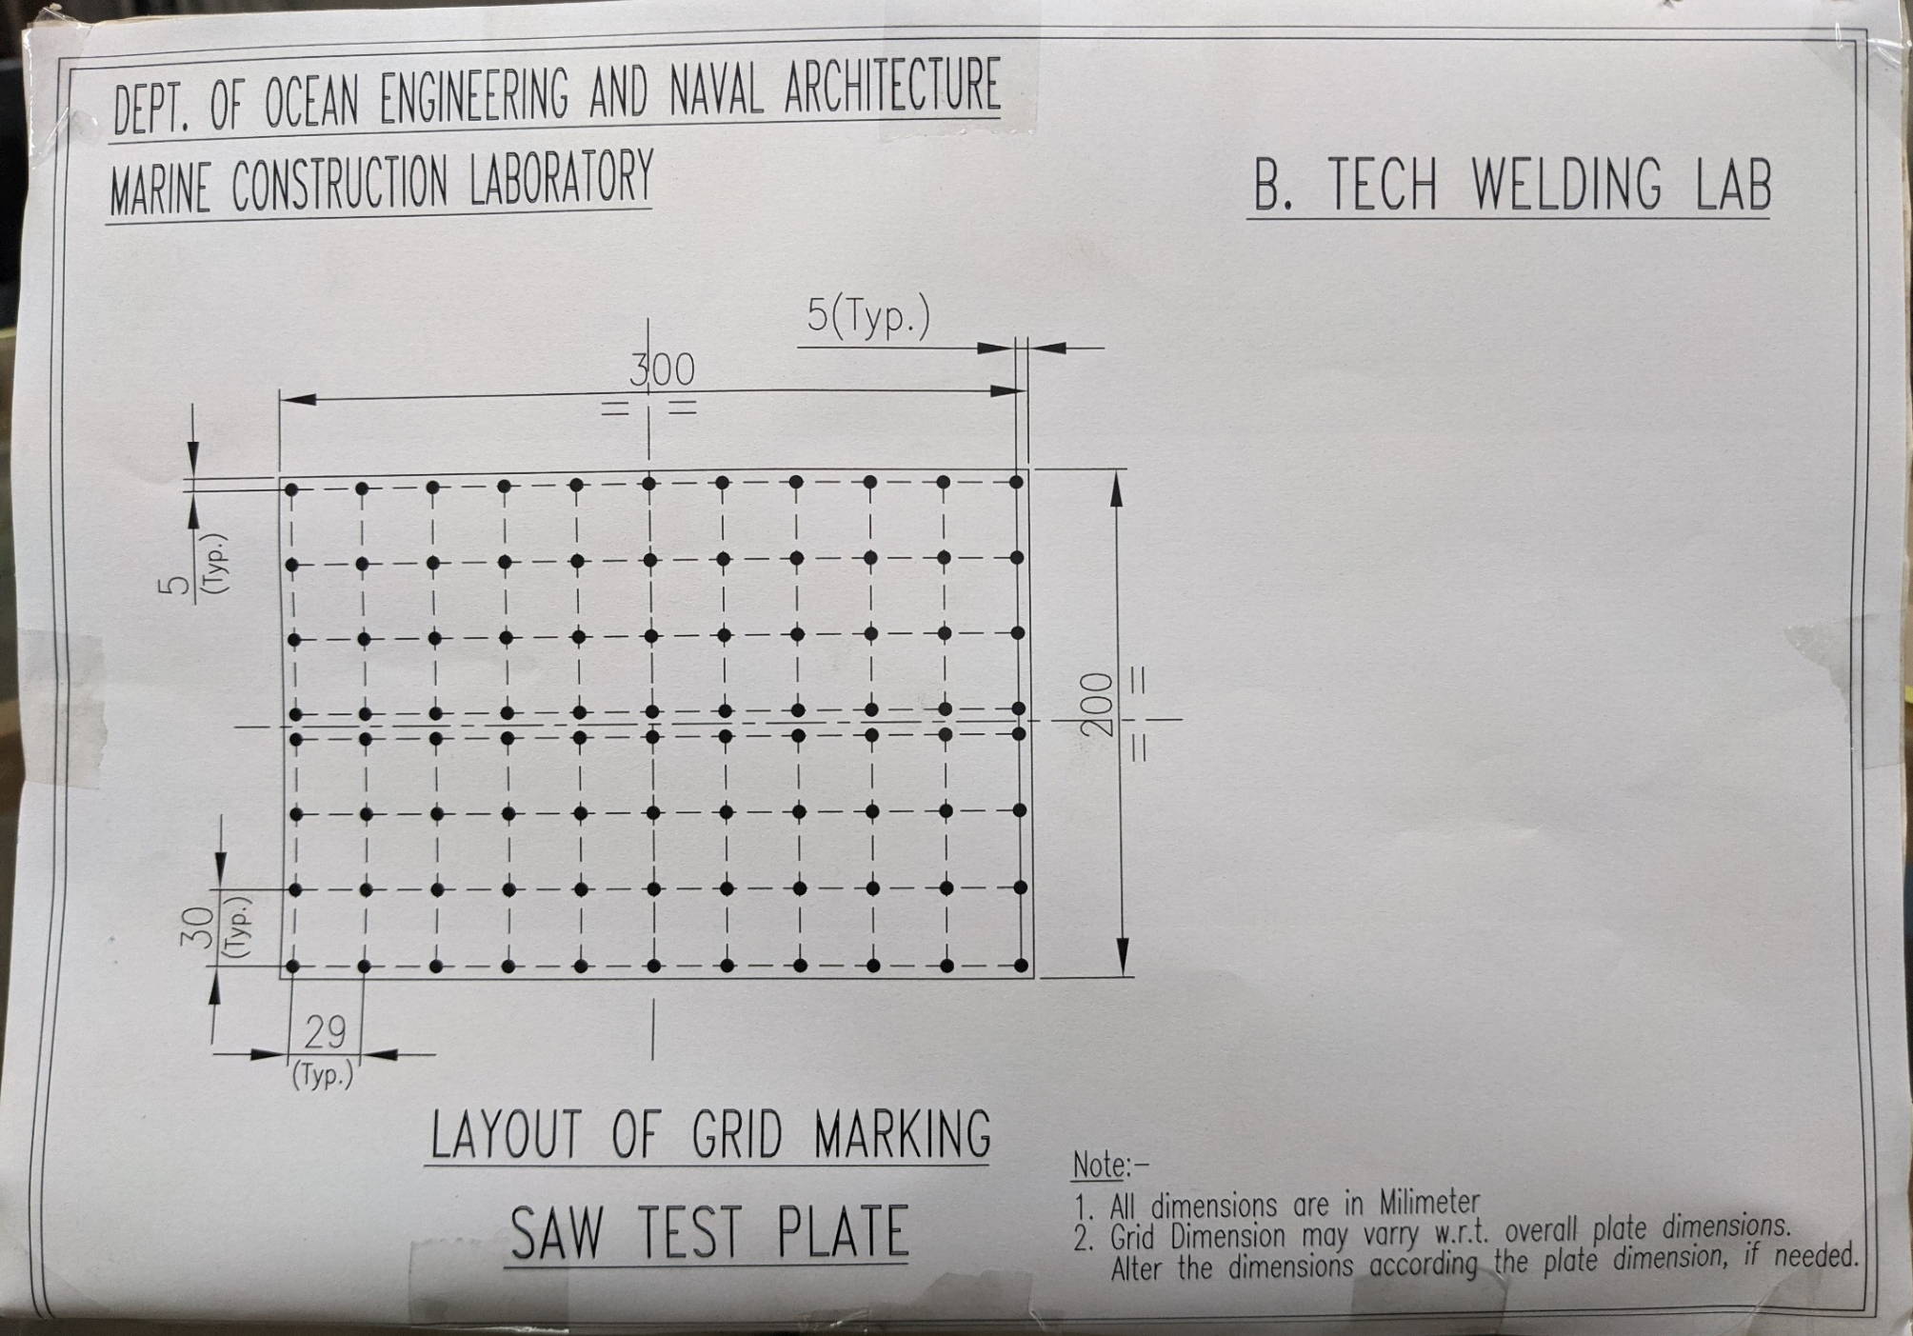
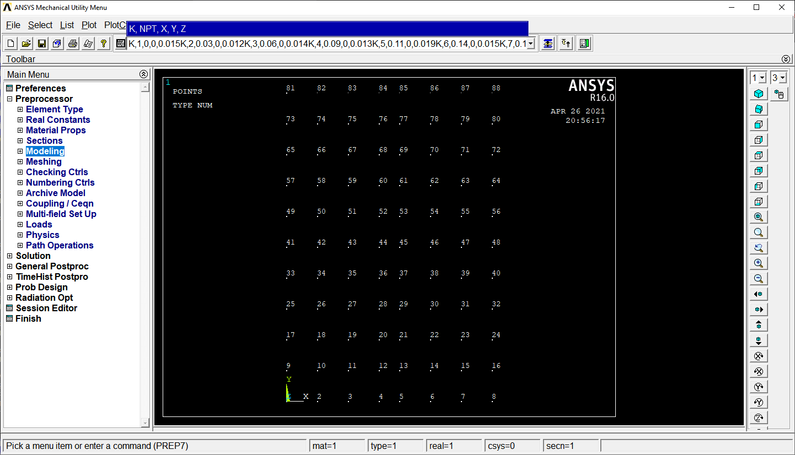

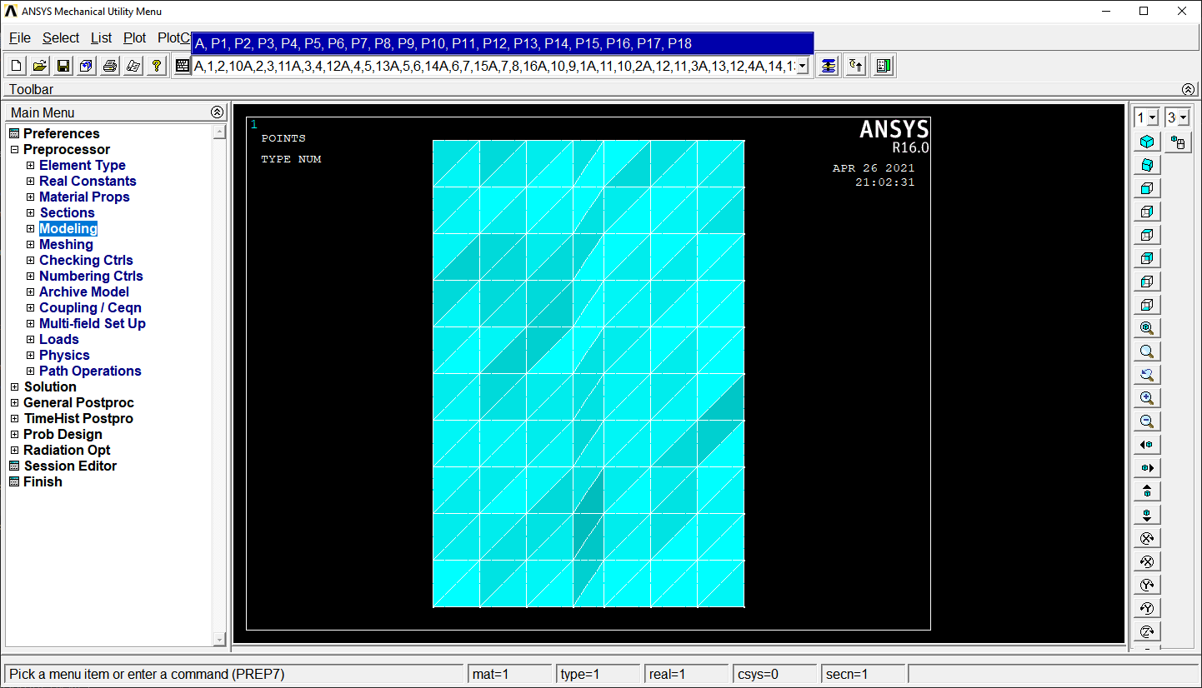
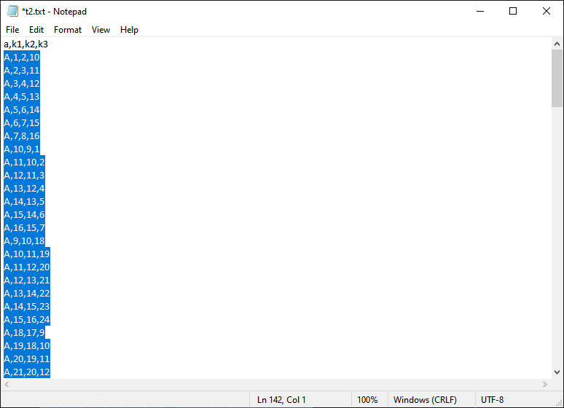
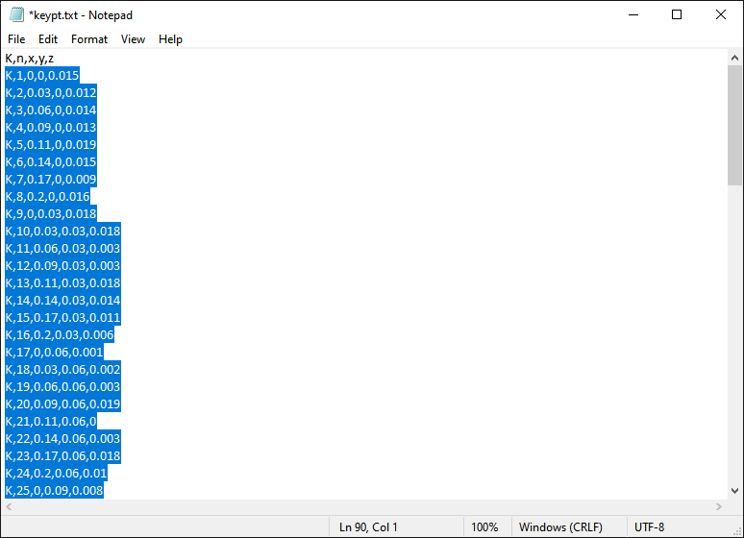
4
Geometric Modelling (Keypoints and Area)
Commands –
/PREP7 – initialize Model creation preprocessor
K,n,x,y,z – Create Keypoint number ‘n’ at ‘x’, ‘y’, ‘z’ coordinate
A,1,2,3 – Create a triangular area between Keypoints 1,2,3
Copy Area, Keypoint inter-connectivity data
And
Paste in APDL Command Line and press ENTER
Keypoints – 88
Area – 141
Copy Co-ordinate data
And
Paste in APDL Command Line and press ENTER

Slide 7
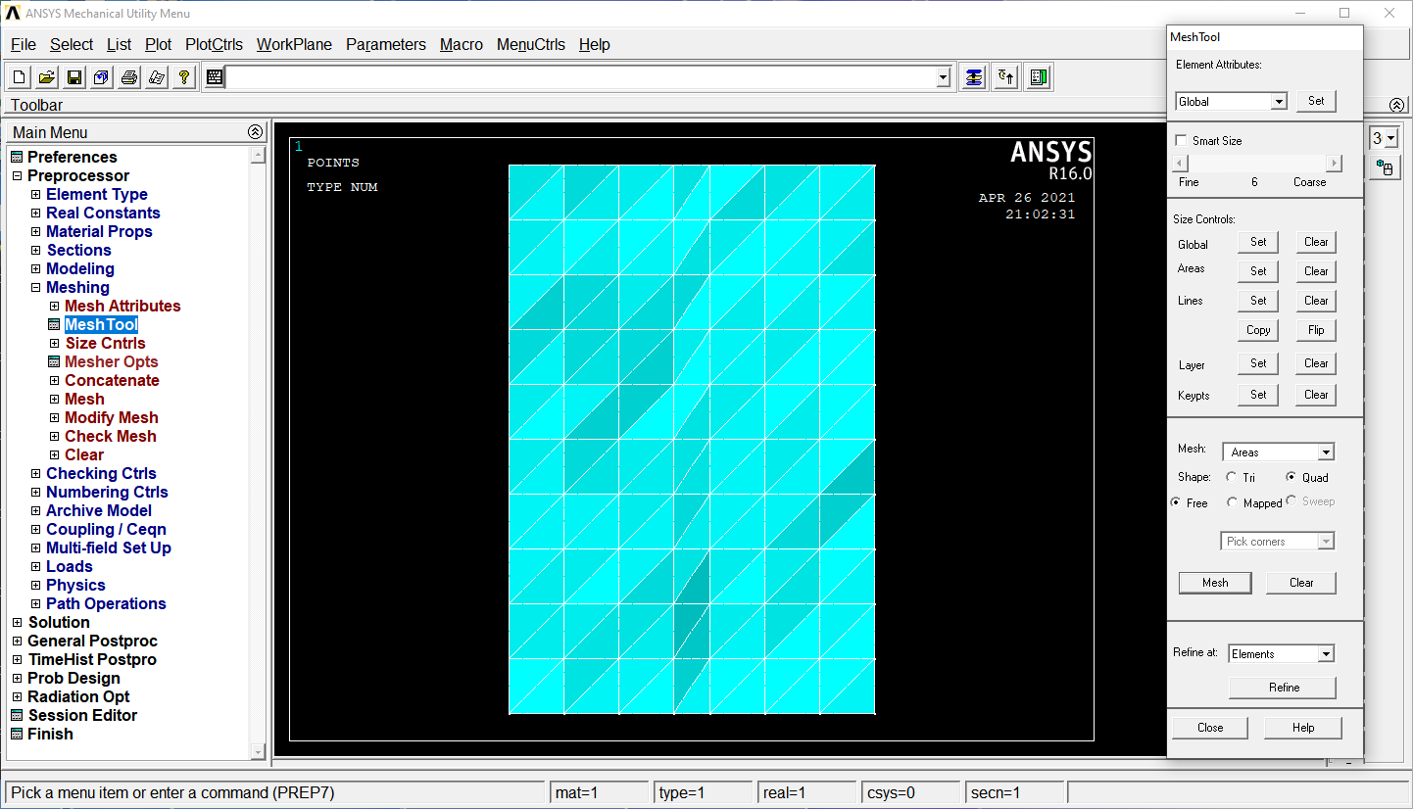
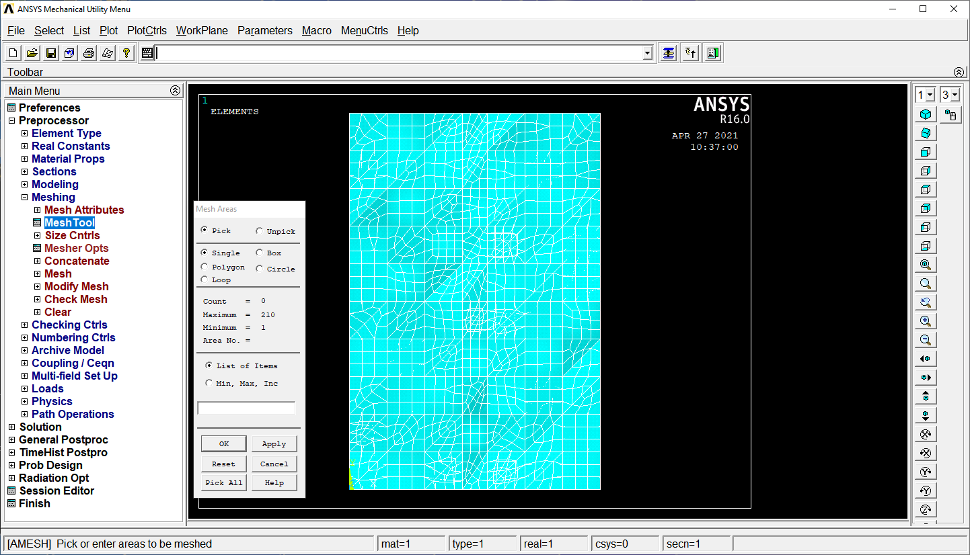
5
Meshing
2
1

Slide 8
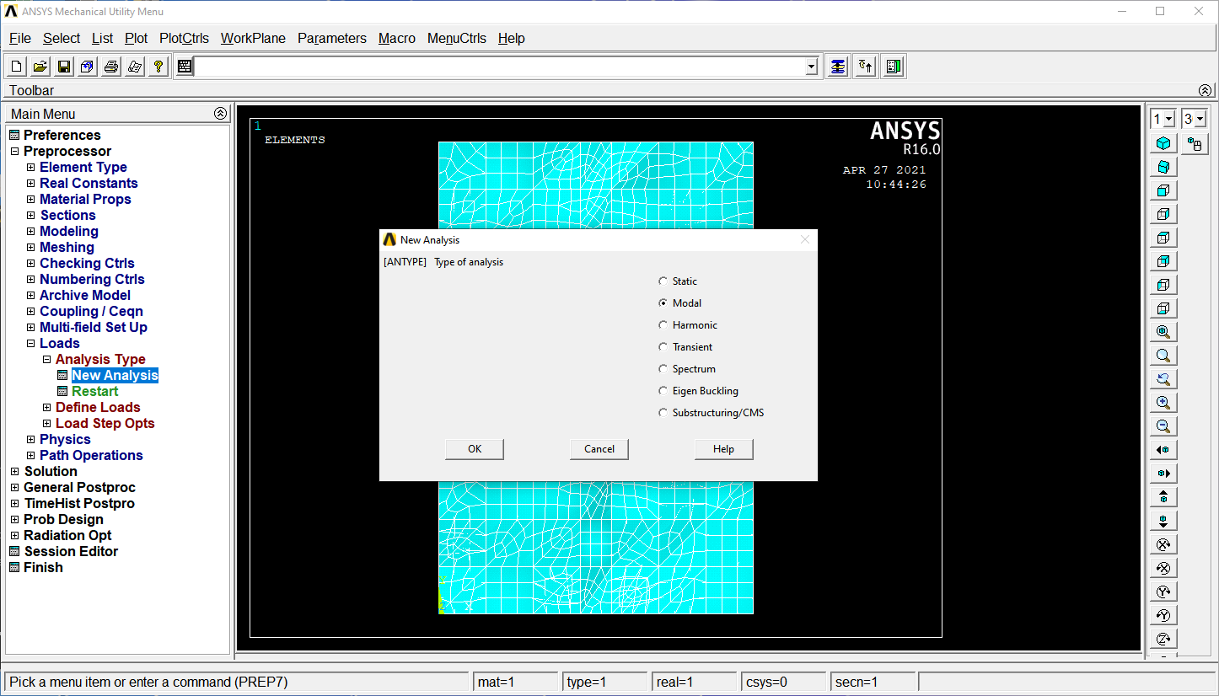
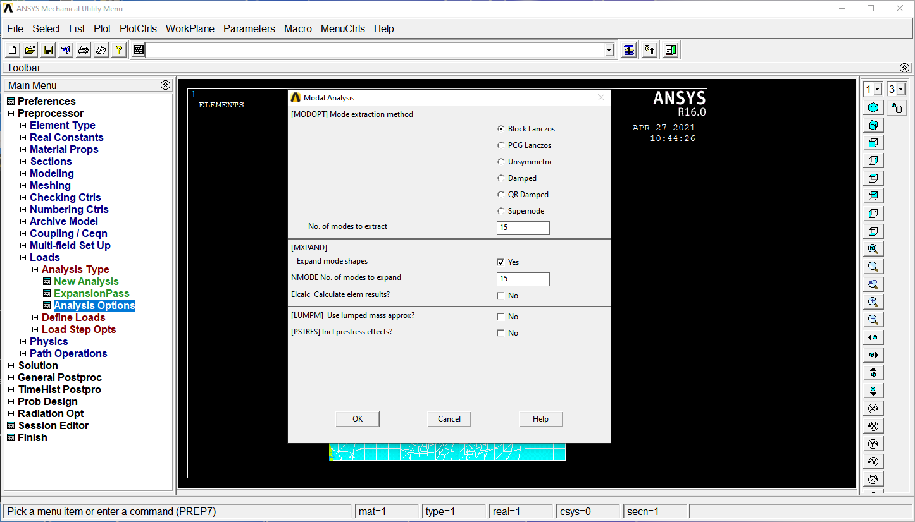
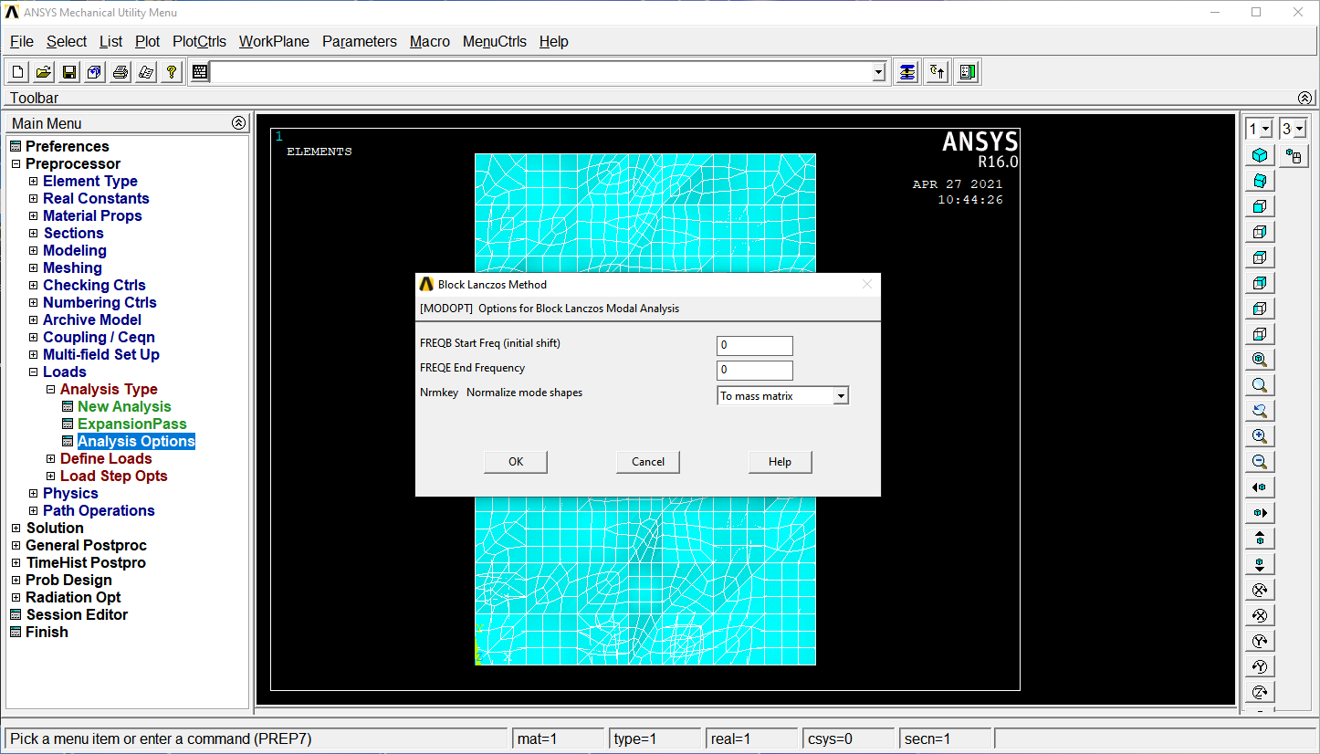
6
Analysis Type
Modal Analysis
Free-Free Boundary condition
Modes to be extracted – 15
(including 6 Rigid modes)

Slide 9
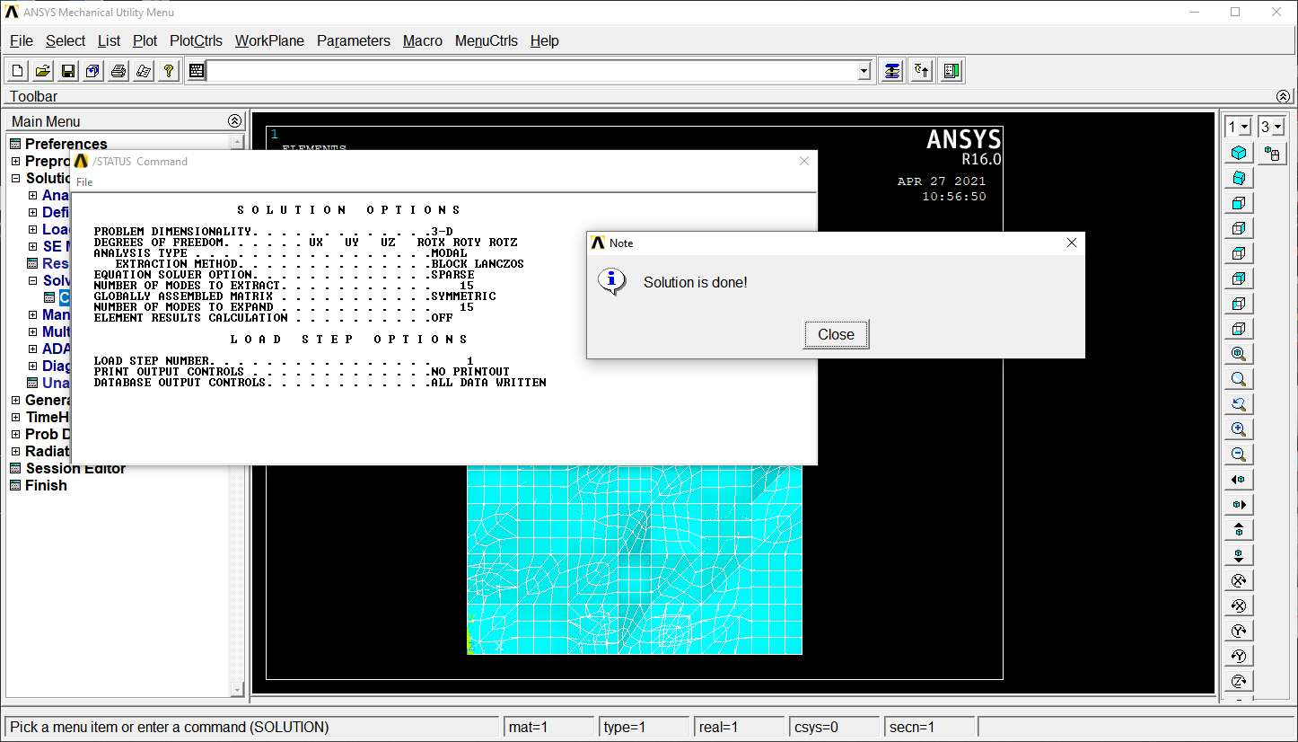
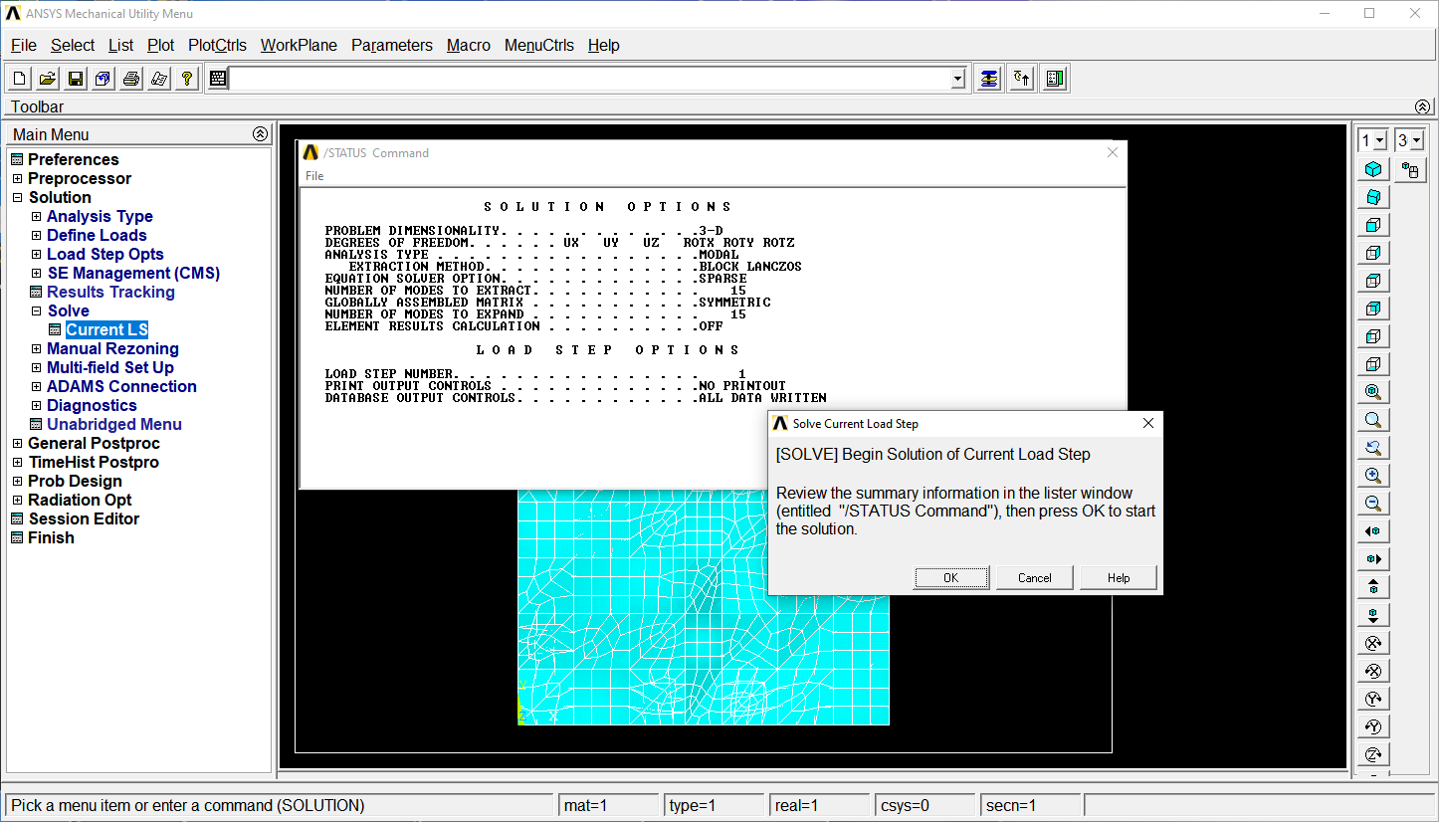
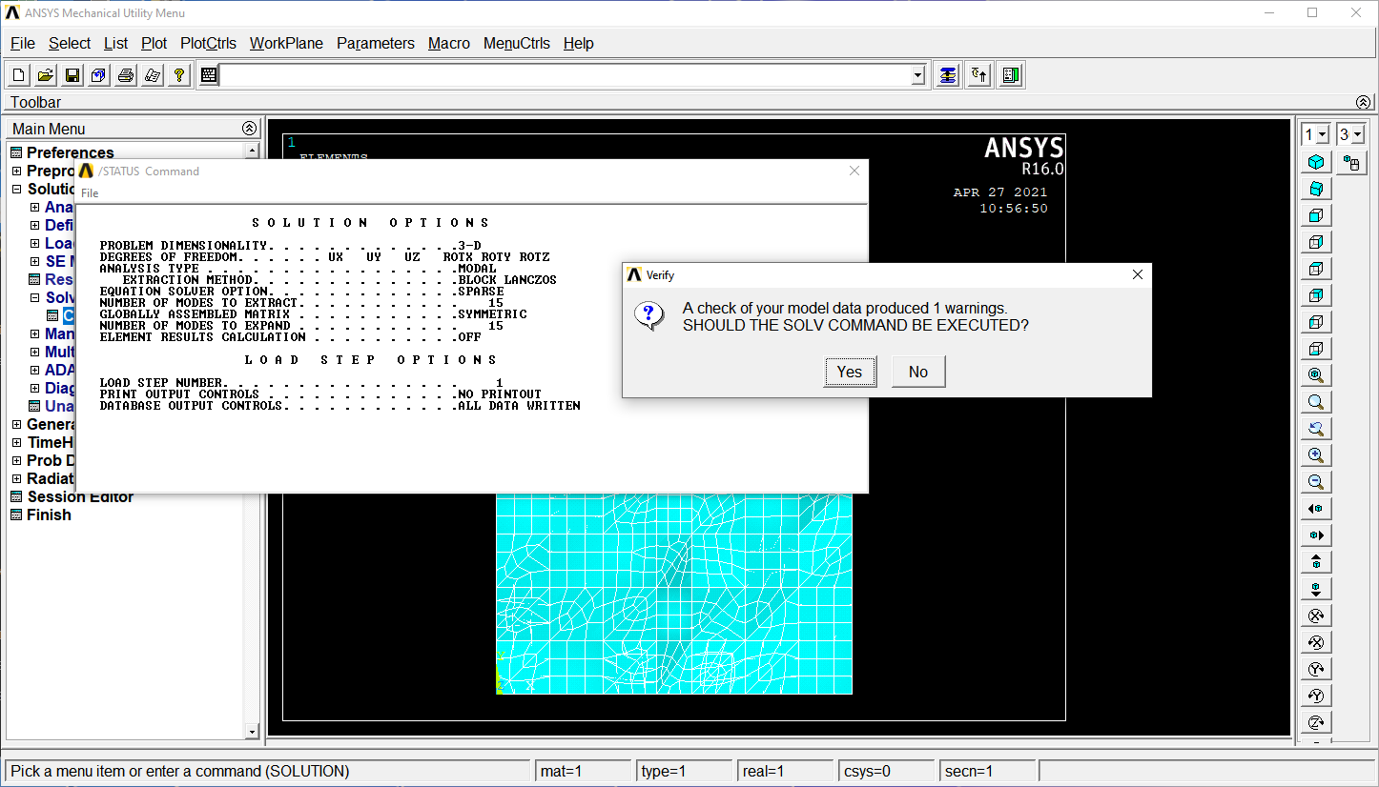
7
Solve for Solution

Slide 10
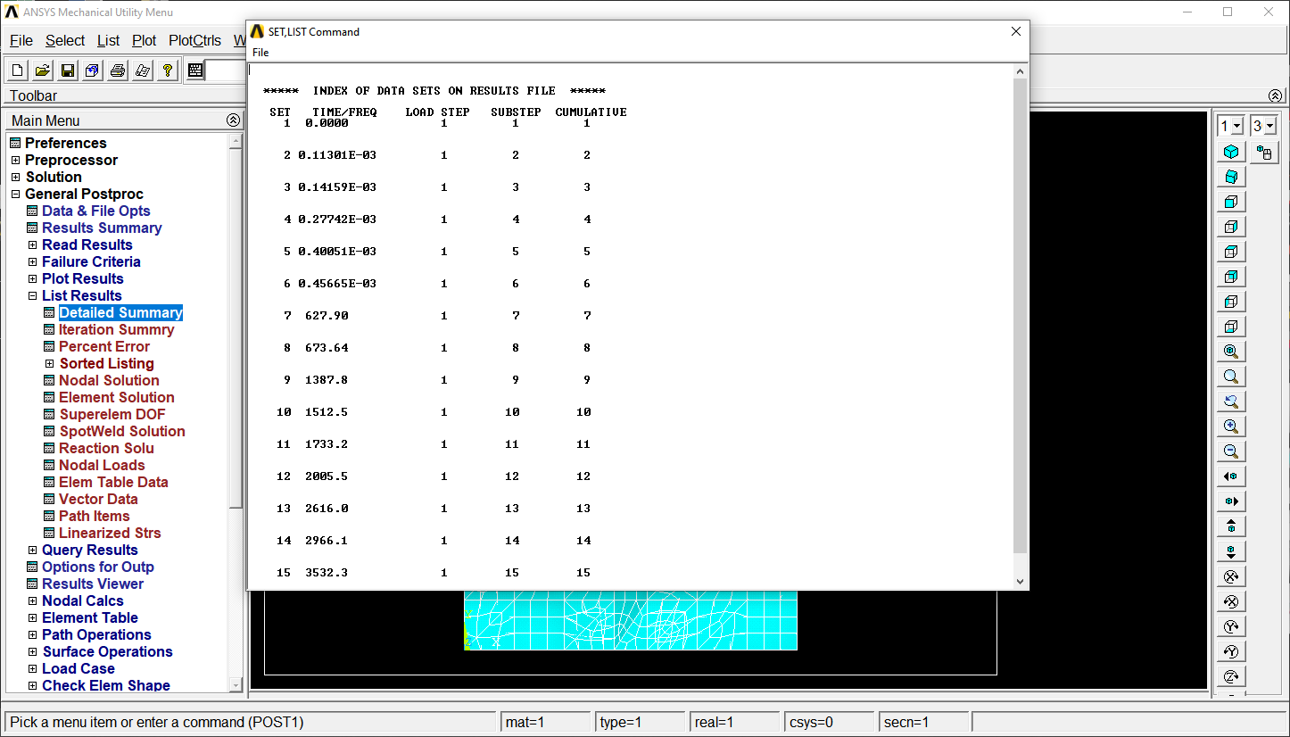
8
Results (Post Processing)
Detailed Summary in List Results

Slide 11
Compare Results Before and After SAW
Deformation in plate due to thermal expansion and residual stresses generated during SAW.
Change coordinate data measured after welding and repeat all the steps(1-8).
Notice change in natural frequency of plate before and after SAW.

Slide 12
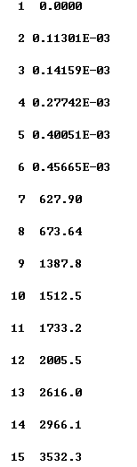
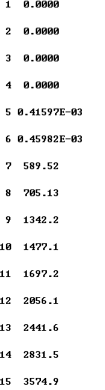
Results (Before and After)
Before SAW
After SAW

